Slide 1

DIGICHROME ACADEMY
NEXT HIKES
2023-24

Slide 2

PROJECT – 06
PHARMACEUTICAL SALES PREDICTION
ACROSS MULTIPLE STORES
ANKUR KUMAR GIRI
2023-24

Slide 3
PROBLEM STATEMENT
EXPLORATORY DATA ANALYSIS IS THE LIFEBLOOD OF EVERY MEANINGFUL MACHINE-LEARNING PROJECT. IT HELPS US UNRAVEL THE NATURE OF THE DATA AND SOMETIMES INFORMS HOW YOU GO ABOUT MODELLING. A CAREFUL EXPLORATION OF THE DATA ENCAPSULATES CHECKING ALL AVAILABLE FEATURES, CHECKING THEIR INTERACTIONS AND CORRELATION AS WELL AS THEIR VARIABILITY WITH RESPECT TO THE TARGET. IN THIS TASK, YOU SEEK TO EXPLORE THE BEHAVIOUR OF CUSTOMERS IN THE VARIOUS STORES. OUR GOAL IS TO CHECK HOW SOME MEASURES SUCH AS PROMOS AND OPENING OF NEW STORES AFFECT PURCHASING BEHAVIOR. TO ACHIEVE THIS GOAL, YOU NEED TO FIRST CLEAN THE DATA. THE DATA CLEANING PROCESS WILL INVOLVE BUILDING PIPELINES TO DETECT AND HANDLE OUTLIER AND MISSING DATA. THIS IS PARTICULARLY IMPORTANT BECAUSE YOU DON’T WANT TO SKEW OUR ANALYSIS. VISUALIZING VARIOUS FEATURES AND INTERACTIONS IS NECESSARY FOR CLEARLY COMMUNICATING OUR F INDINGS. IT IS A POWERFUL TOOL IN THE DATA SCIENCE TOOLBOX. COMMUNICATE THE FINDINGS BELOW VIA THE NECESSARY PLOTS.

Slide 4
SITUATIONAL OVERVIEW (BUSINESS NEED)
MACHINE LEARNING ENGINEER AND A COMPANY CALLED ROSSMANN PHARMACEUTICALS HAS GIVEN YOU A PROJECT ON SALES FORECASTING. THE FINANCE TEAM WANTS TO FORECAST SALES IN ALL THEIR STORES ACROSS SEVERAL CITIES SIX WEEKS AHEAD OF TIME. MANAGERS IN INDIVIDUAL STORES RELY ON THEIR YEARS OF EXPERIENCE AS WELL AS THEIR PERSONAL JUDGEMENT TO FORECAST SALES. THE DATA TEAM IDENTIFIED FACTORS SUCH AS PROMOTIONS, COMPETITION, SCHOOL AND STATE HOLIDAYS, SEASONALITY, AND LOCALITY AS NECESSARY FOR PREDICTING SALES ACROSS THE VARIOUS STORES

Slide 5
EXPLORATORY DATA ANALYSIS (EDA)
CONTENTS
STEPS IN EXPLORATORY DATA ANALYSIS (EDA)
SOFTWARE REQUIREMENTS
FLOW CHART OF EXPLORATORY DATA ANALYSIS .

Slide 6
EXPLORATORY DATA ANALYSIS
EXPLORATORY DATA ANALYSIS (EDA) IS A CRUCIAL INITIAL STEP IN ANY DATA ANALYSIS PROJECT. IT INVOLVES EXAMINING AND UNDERSTANDING THE CHARACTERISTICS, PATTERNS, AND RELATIONSHIPS PRESENT IN A DATASET. EDA ALLOWS DATA SCIENTISTS AND ANALYSTS TO GAIN INSIGHTS INTO THE DATA, IDENTIFY POTENTIAL PROBLEMS OR ANOMALIES, AND FORMULATE HYPOTHESES FOR FURTHER INVESTIGATION.
UNDERSTAND THE DATA: GET A COMPREHENSIVE UNDERSTANDING OF THE DATASET, INCLUDING ITS STRUCTURE, VARIABLES, AND THEIR TYPES. THIS INVOLVES EXPLORING THE DIMENSIONS OF THE DATASET (NUMBER OF ROWS AND COLUMNS), DATA TYPES (NUMERIC, CATEGORICAL, ETC.), AND ANY MISSING OR NULL VALUES.

Slide 7
EXPLORATORY DATA ANALYSIS
DETECT PATTERNS AND RELATIONSHIPS: IDENTIFY PATTERNS, TRENDS, AND RELATIONSHIPS BETWEEN VARIABLES IN THE DATASET. THIS INCLUDES EXAMINING DISTRIBUTIONS, CORRELATIONS, AND DEPENDENCIES AMONG DIFFERENT FEATURES
UNCOVER ANOMALIES AND OUTLIERS: DETECT ANY OUTLIERS OR ANOMALIES THAT MAY INDICATE ERRORS IN DATA COLLECTION OR PROCESSING. THESE OUTLIERS COULD BE LEGITIMATE DATA POINTS WITH UNUSUAL CHARACTERISTICS OR ERRORS THAT NEED TO BE ADDRESSED.
FORMULATE HYPOTHESES: BASED ON THE INSIGHTS GAINED FROM EDA, GENERATE HYPOTHESES OR RESEARCH QUESTIONS TO EXPLORE FURTHER THROUGH STATISTICAL ANALYSIS OR MACHINE LEARNING MODELING

Slide 8
EXPLORATORY DATA ANALYSIS
EDA IS TYPICALLY PERFORMED USING A COMBINATION OF DESCRIPTIVE STATISTICS, DATA VISUALIZATION TECHNIQUES, AND SOMETIMES, ADVANCED ANALYTICS METHODS. DESCRIPTIVE STATISTICS HELP SUMMARIZE THE CENTRAL TENDENCY, DISPERSION, AND SHAPE OF THE DATA, WHILE VISUALIZATION TECHNIQUES SUCH AS HISTOGRAMS, SCATTER PLOTS, BOX PLOTS, AND HEATMAPS PROVIDE GRAPHICAL REPRESENTATIONS OF THE DATA DISTRIBUTION AND RELATIONSHIPS.
EDA IS AN ITERATIVE PROCESS, WHERE INSIGHTS GAINED AT EACH STAGE MAY LEAD TO FURTHER EXPLORATION OR REFINEMENT OF ANALYSIS TECHNIQUES. IT SERVES AS A FOUNDATION FOR MORE ADVANCED ANALYSIS AND MODELING TASKS, HELPING ENSURE THAT SUBSEQUENT ANALYSES ARE BASED ON A SOLID UNDERSTANDING OF THE DATASET.
IN SUMMARY, EXPLORATORY DATA ANALYSIS IS A CRITICAL PHASE IN THE DATA ANALYSIS WORKFLOW, ENABLING DATA SCIENTISTS AND ANALYSTS TO GAIN INSIGHTS, IDENTIFY PATTERNS, AND FORMULATE HYPOTHESES TO GUIDE FURTHER ANALYSIS AND DECISION-MAKING.

Slide 9
STEPS IN EXPLORATORY DATA ANALYSIS (EDA)
EXPLORATORY DATA ANALYSIS (EDA) IS A CRITICAL STEP IN DATA ANALYSIS WHERE YOU EXAMINE AND SUMMARIZE THE MAIN CHARACTERISTICS OF A DATASET, USUALLY THROUGH VISUALIZATION AND DESCRIPTIVE STATISTICS. IT HELPS YOU UNDERSTAND YOUR DATA, FIND PATTERNS, DETECT ANOMALIES, AND FORMULATE HYPOTHESES FOR FURTHER ANALYSIS. EDA INVOLVES TASKS LIKE:
DATA CLEANING: HANDLING MISSING VALUES, DEALING WITH OUTLIERS, AND RESOLVING INCONSISTENCIES IN THE DATA.
DESCRIPTIVE STATISTICS: COMPUTING MEASURES LIKE MEAN, MEDIAN, MODE, STANDARD DEVIATION, ETC., TO UNDERSTAND THE CENTRAL TENDENCY AND DISPERSION OF THE DATA.
VISUALIZATION: CREATING PLOTS SUCH AS HISTOGRAMS, BOX PLOTS, SCATTER PLOTS, AND HEATMAPS TO VISUALIZE THE DISTRIBUTION, RELATIONSHIPS, AND TRENDS IN THE DATA.
FEATURE ENGINEERING: CREATING NEW FEATURES FROM EXISTING ONES OR TRANSFORMING FEATURES TO BETTER REPRESENT THE UNDERLYING PATTERNS IN THE DATA.

Slide 10
STEPS IN EXPLORATORY DATA ANALYSIS (EDA)
EXPLORATORY DATA ANALYSIS (EDA) IS A CRITICAL STEP IN DATA ANALYSIS WHERE YOU EXAMINE AND SUMMARIZE THE MAIN CHARACTERISTICS OF A DATASET, USUALLY THROUGH VISUALIZATION AND DESCRIPTIVE STATISTICS. IT HELPS YOU UNDERSTAND YOUR DATA, FIND PATTERNS, DETECT ANOMALIES, AND FORMULATE HYPOTHESES FOR FURTHER ANALYSIS. EDA INVOLVES TASKS LIKE:
DATA CLEANING: HANDLING MISSING VALUES, DEALING WITH OUTLIERS, AND RESOLVING INCONSISTENCIES IN THE DATA.
DESCRIPTIVE STATISTICS: COMPUTING MEASURES LIKE MEAN, MEDIAN, MODE, STANDARD DEVIATION, ETC., TO UNDERSTAND THE CENTRAL TENDENCY AND DISPERSION OF THE DATA.
VISUALIZATION: CREATING PLOTS SUCH AS HISTOGRAMS, BOX PLOTS, SCATTER PLOTS, AND HEATMAPS TO VISUALIZE THE DISTRIBUTION, RELATIONSHIPS, AND TRENDS IN THE DATA.
DIMENSIONALITY REDUCTION: TECHNIQUES LIKE PRINCIPAL COMPONENT ANALYSIS (PCA) OR T-DISTRIBUTED STOCHASTIC NEIGHBOR EMBEDDING (T-SNE) TO REDUCE THE NUMBER OF FEATURES AND SIMPLIFY THE DATASET WHILE PRESERVING ITS ESSENTIAL CHARACTERISTICS.

Slide 11
STEPS IN EXPLORATORY DATA ANALYSIS (EDA)
CORRELATION ANALYSIS: EXAMINING THE RELATIONSHIPS BETWEEN VARIABLES TO IDENTIFY POTENTIAL DEPENDENCIES OR MULTICOLLINEARITY
UNDERSTANDING THE DATA: START BY LOADING YOUR DATASET AND UNDERSTANDING ITS STRUCTURE. LOOK AT THE DIMENSIONS (NUMBER OF ROWS AND COLUMNS), DATA TYPES, AND ANY MISSING VALUES. THIS STAGE INVOLVES GETTING A GENERAL SENSE OF WHAT INFORMATION IS AVAILABLE AND ITS QUALITY.
UNIVARIATE ANALYSIS: ANALYZE INDIVIDUAL VARIABLES ONE AT A TIME. THIS CAN INVOLVE COMPUTING SUMMARY STATISTICS LIKE MEAN, MEDIAN, AND STANDARD DEVIATION FOR NUMERICAL VARIABLES, AND FREQUENCY TABLES OR BAR PLOTS FOR CATEGORICAL VARIABLES. HISTOGRAMS, DENSITY PLOTS, AND BOX PLOTS ARE USEFUL FOR VISUALIZING THE DISTRIBUTION AND SPREAD OF NUMERICAL VARIABLES.
BIVARIATE ANALYSIS: EXPLORE RELATIONSHIPS BETWEEN PAIRS OF VARIABLES. THIS CAN INVOLVE SCATTER PLOTS FOR NUMERIC VARIABLES, OR CONTINGENCY TABLES AND HEATMAP CORRELATION MATRICES FOR CATEGORICAL VARIABLES. UNDERSTANDING THESE RELATIONSHIPS CAN PROVIDE INSIGHTS INTO POTENTIAL PATTERNS OR DEPENDENCIES IN THE DATA.

Slide 12
STEPS IN EXPLORATORY DATA ANALYSIS (EDA)
MULTIVARIATE ANALYSIS: INVESTIGATE INTERACTIONS BETWEEN THREE OR MORE VARIABLES. THIS CAN INVOLVE TECHNIQUES LIKE CLUSTER ANALYSIS, FACTOR ANALYSIS, OR MULTIDIMENSIONAL SCALING TO IDENTIFY GROUPS OR PATTERNS WITHIN THE DATA.
STATISTICAL TESTING: PERFORM STATISTICAL TESTS TO VALIDATE HYPOTHESES OR ASSESS THE SIGNIFICANCE OF RELATIONSHIPS OBSERVED DURING THE ANALYSIS. THIS CAN INCLUDE T-TESTS, ANOVA, CHI-SQUARE TESTS, AND CORRELATION TESTS, DEPENDING ON THE NATURE OF YOUR DATA AND RESEARCH QUESTIONS
DIMENSIONALITY REDUCTION: TECHNIQUES LIKE PRINCIPAL COMPONENT ANALYSIS (PCA) OR T-DISTRIBUTED STOCHASTIC NEIGHBOR EMBEDDING (T-SNE) TO REDUCE THE NUMBER OF FEATURES AND SIMPLIFY THE DATASET WHILE PRESERVING ITS ESSENTIAL CHARACTERISTICS.
FEATURE ENGINEERING: CREATING NEW FEATURES FROM EXISTING ONES OR TRANSFORMING FEATURES TO BETTER REPRESENT THE UNDERLYING PATTERNS IN THE DATA.

Slide 13
SOFTWARE REQUIREMENTS
GOOGLE DRIVE
COLAB

Slide 14


Slide 15
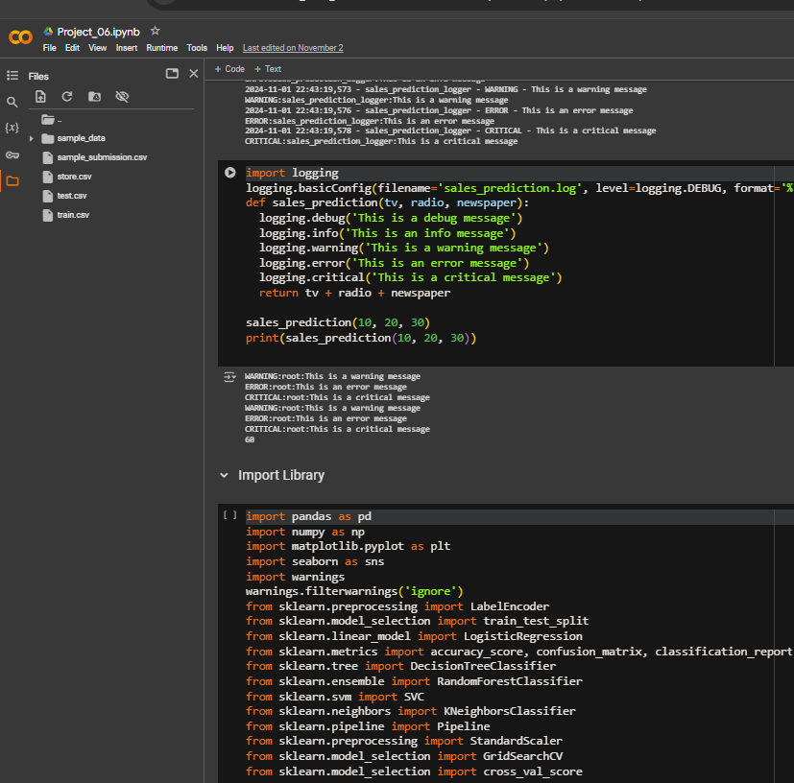
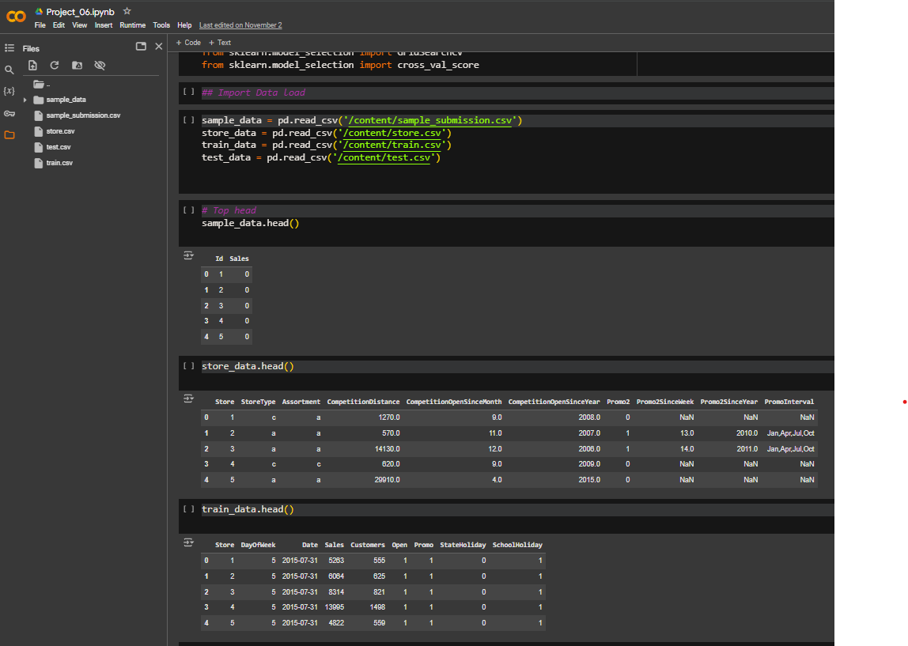

Slide 16
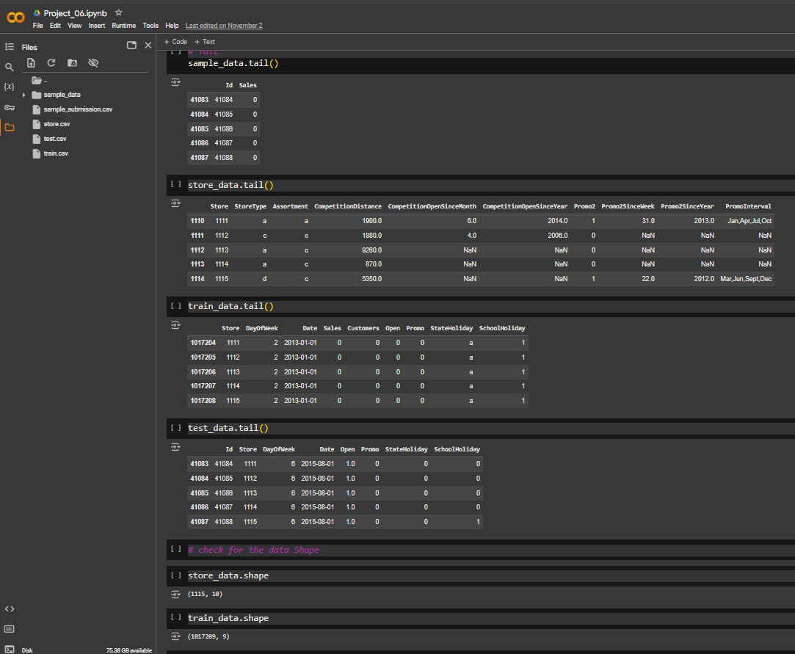
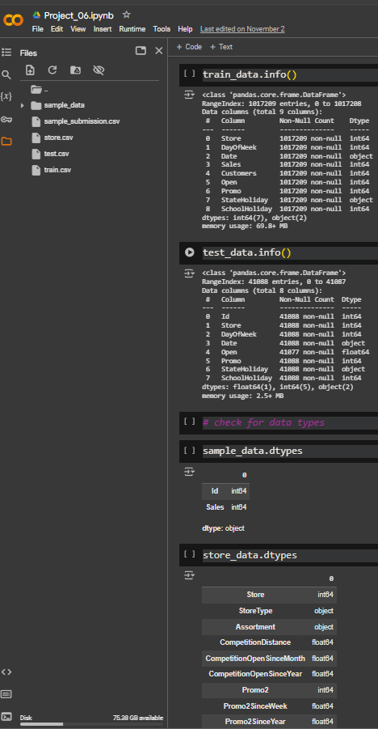

Slide 17
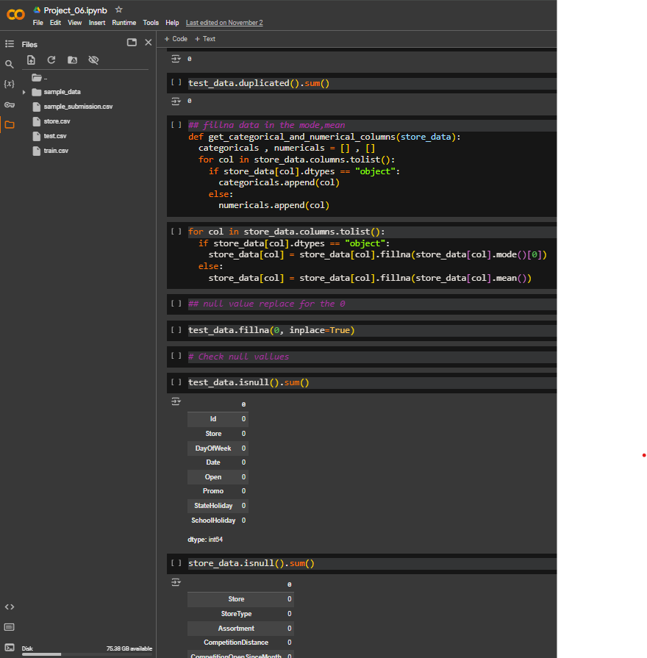
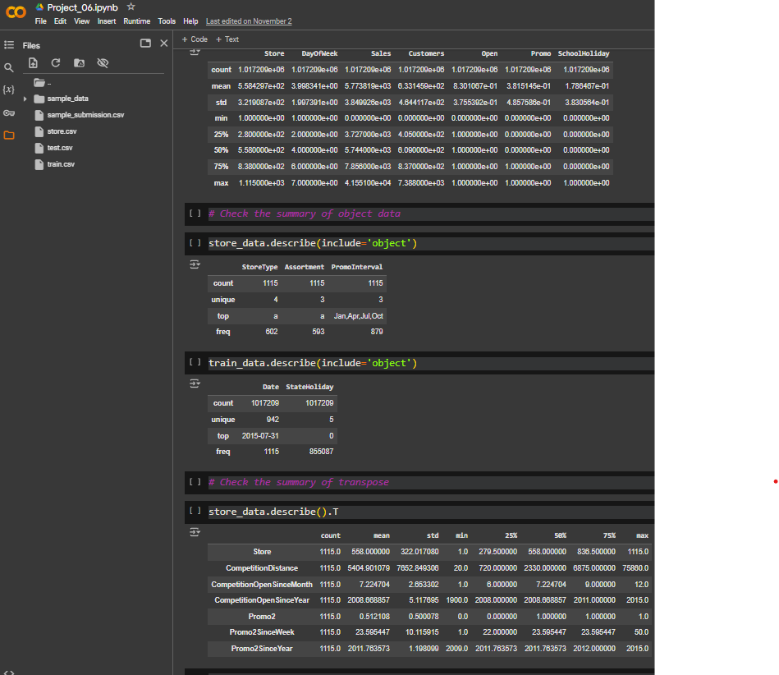

Slide 18
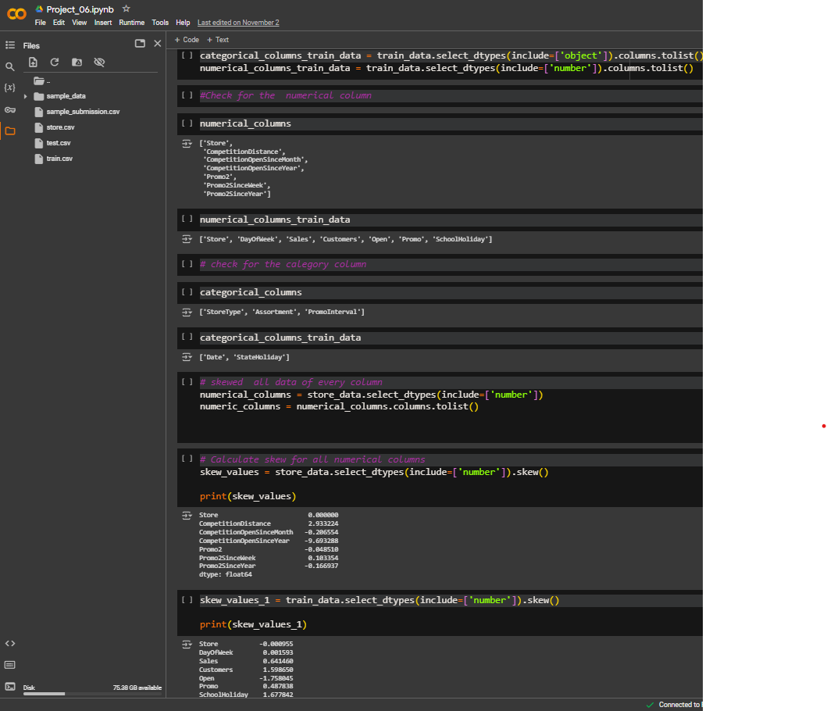
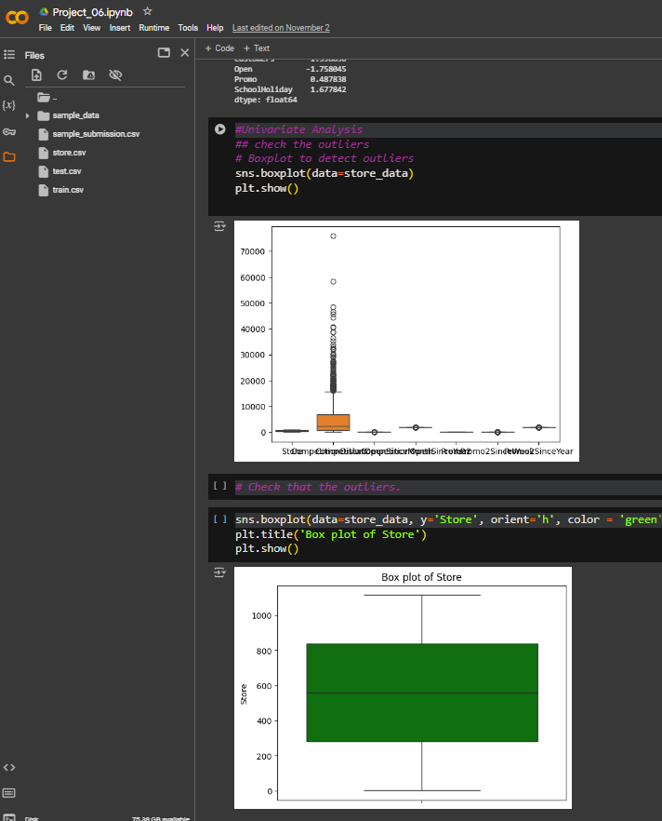

Slide 19
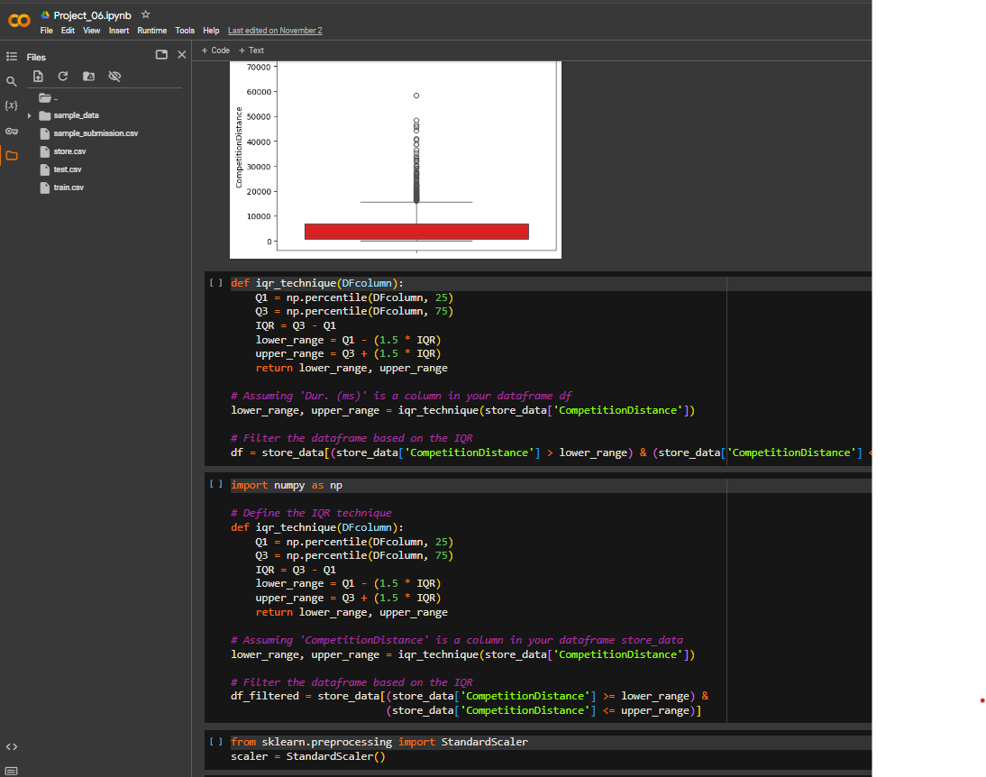
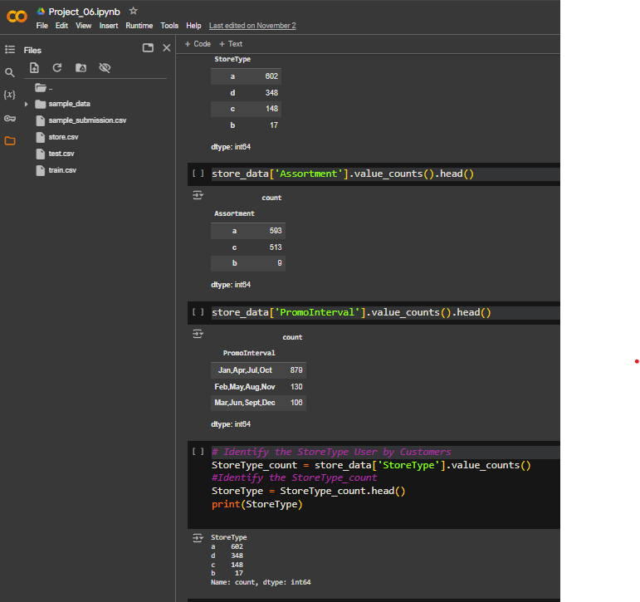

Slide 20
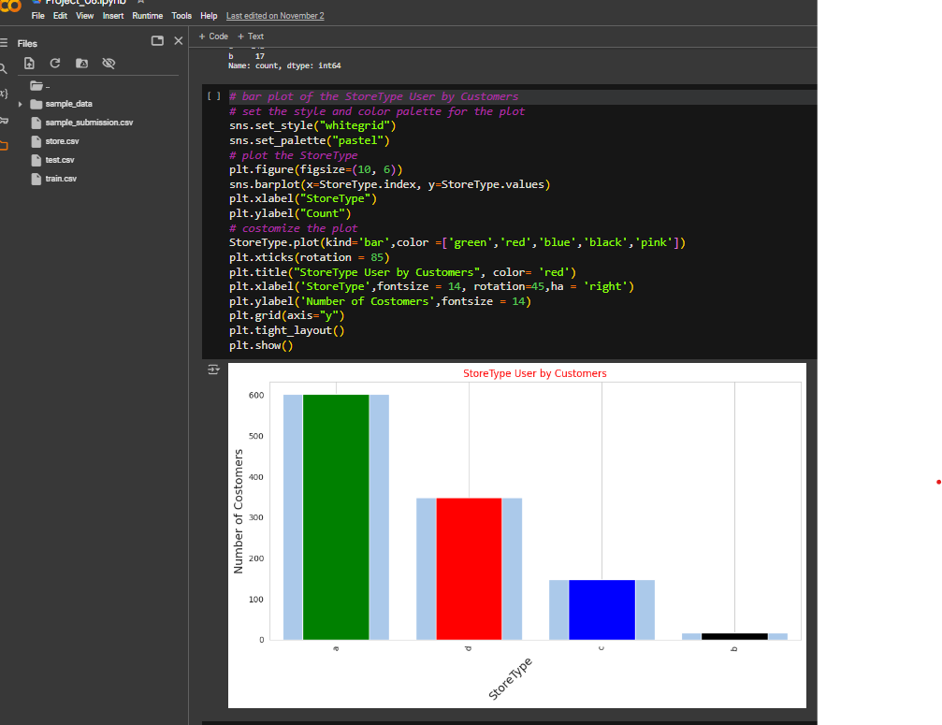
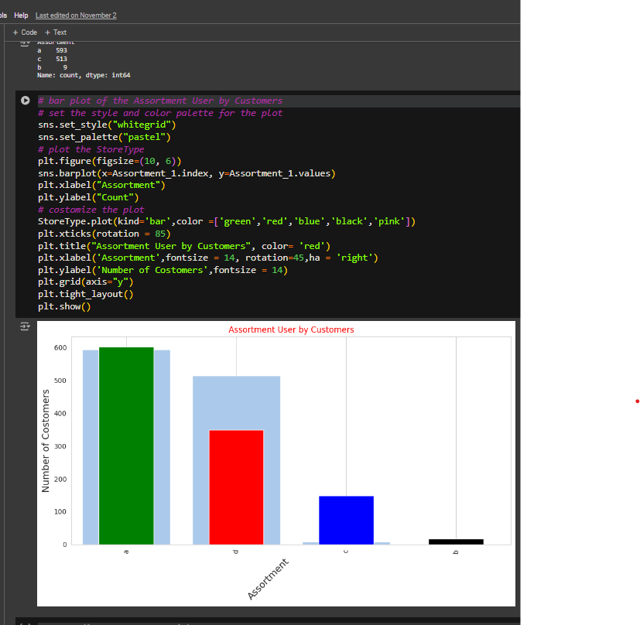

Slide 21
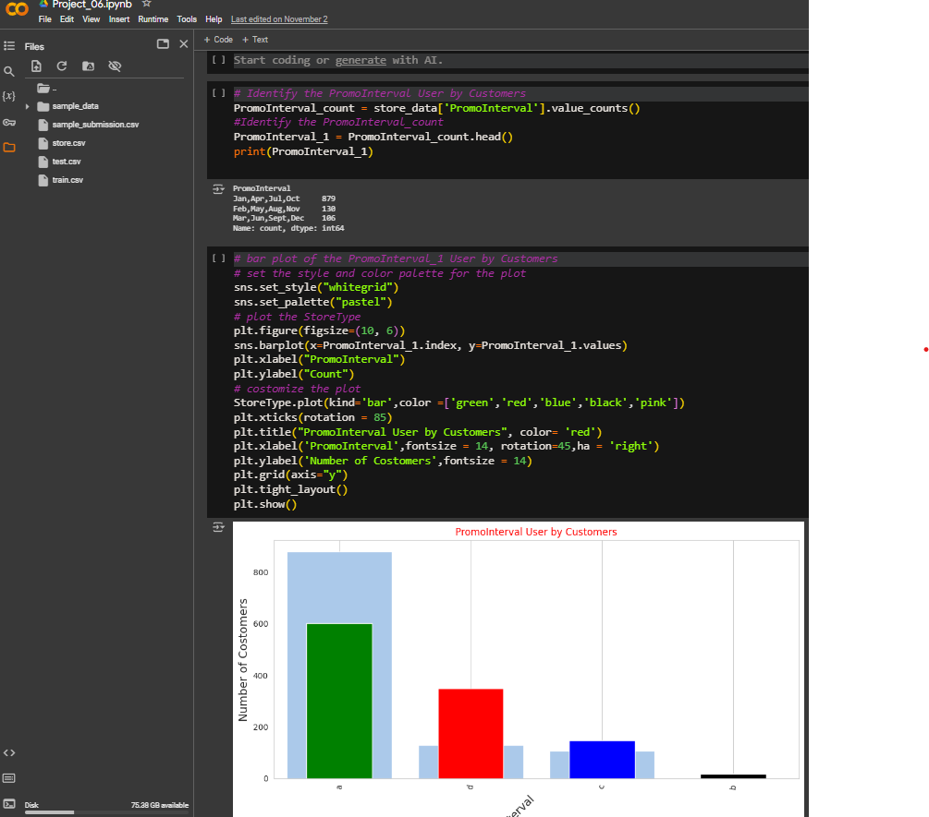
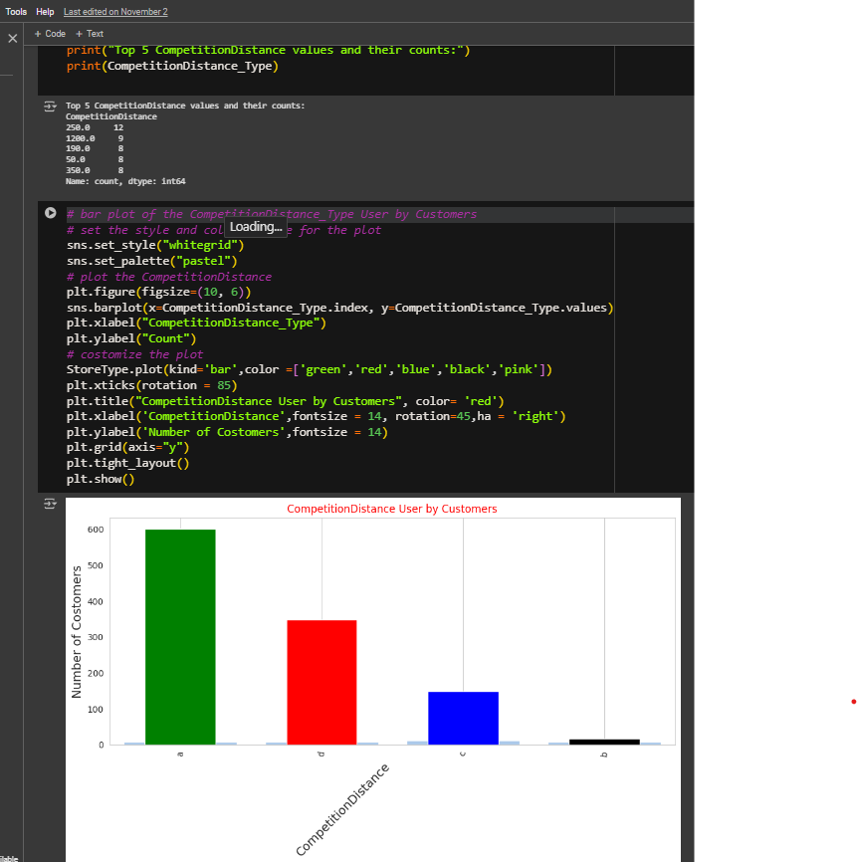

Slide 22
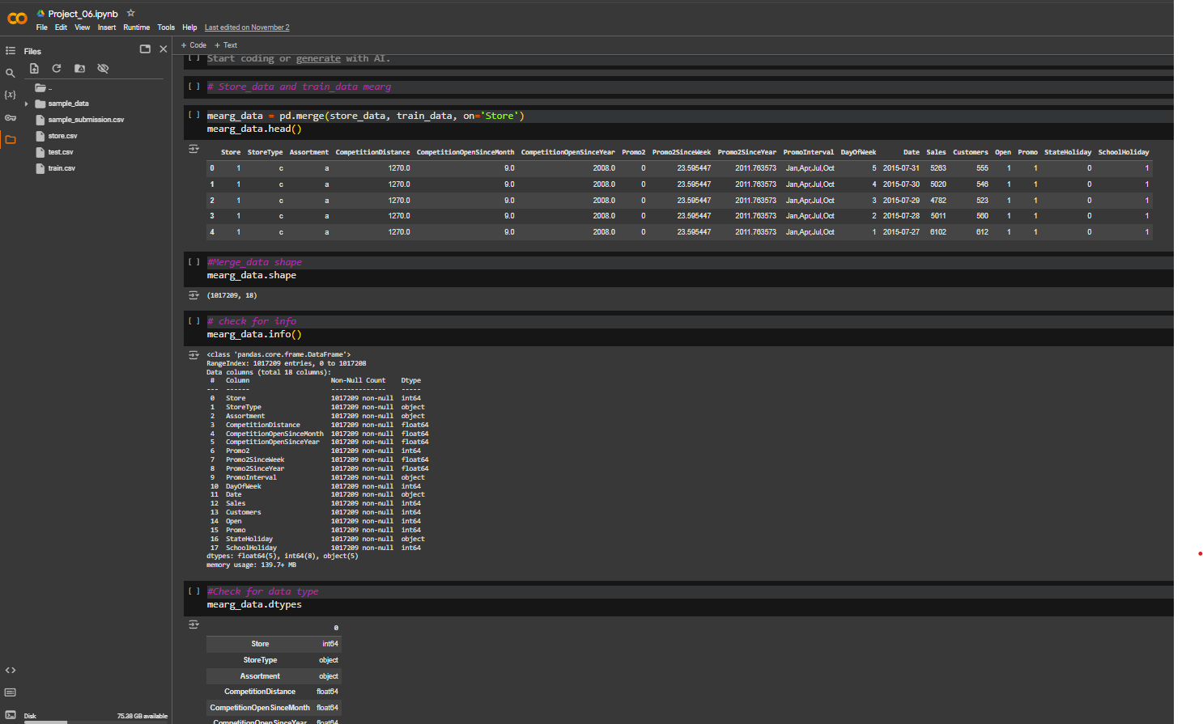

Slide 23
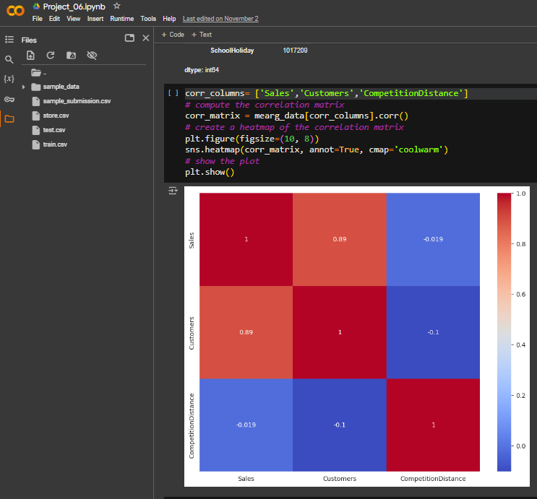
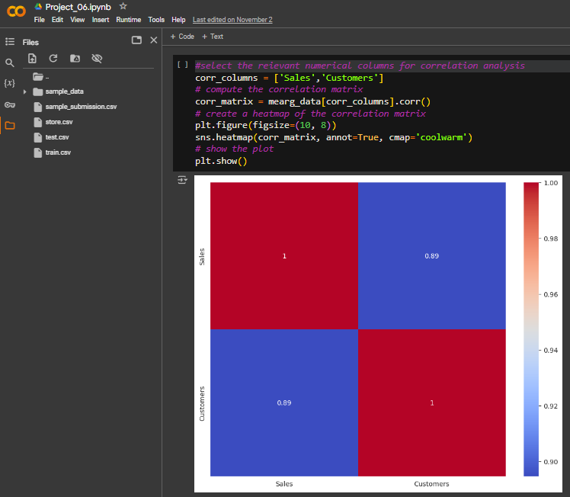

Slide 24
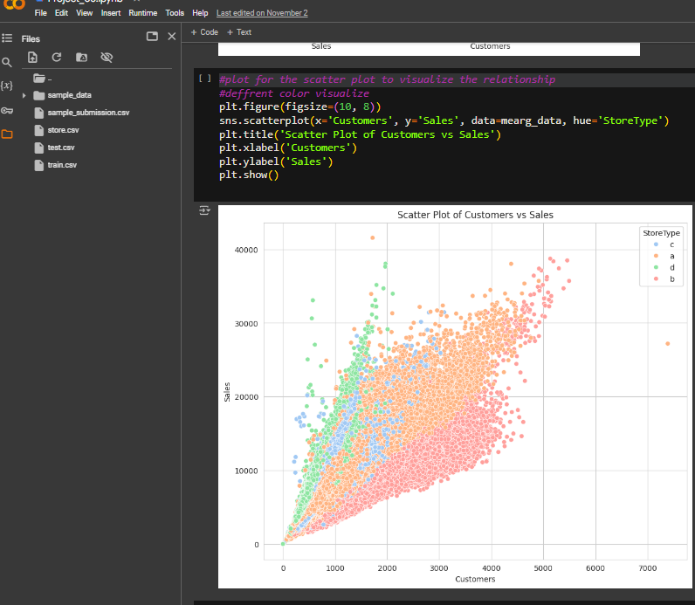

Slide 25
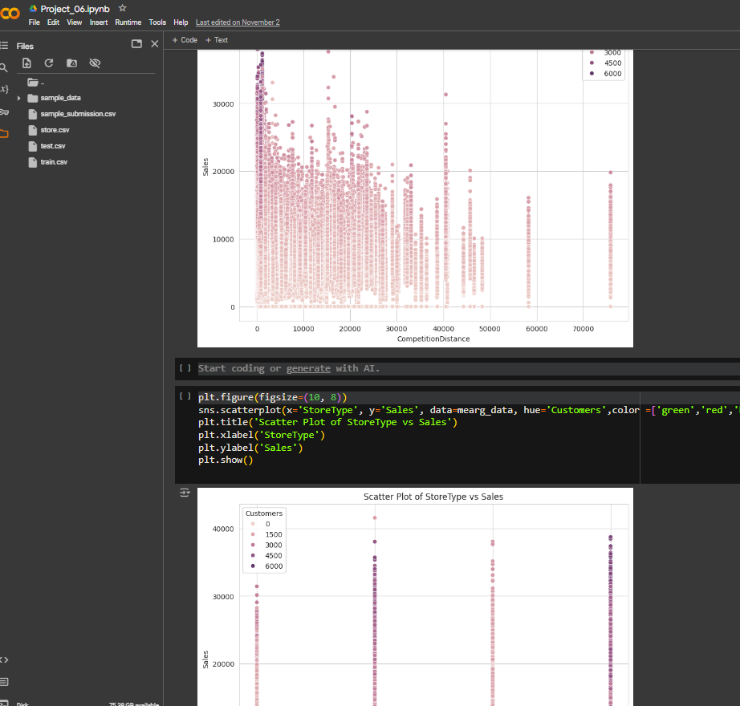
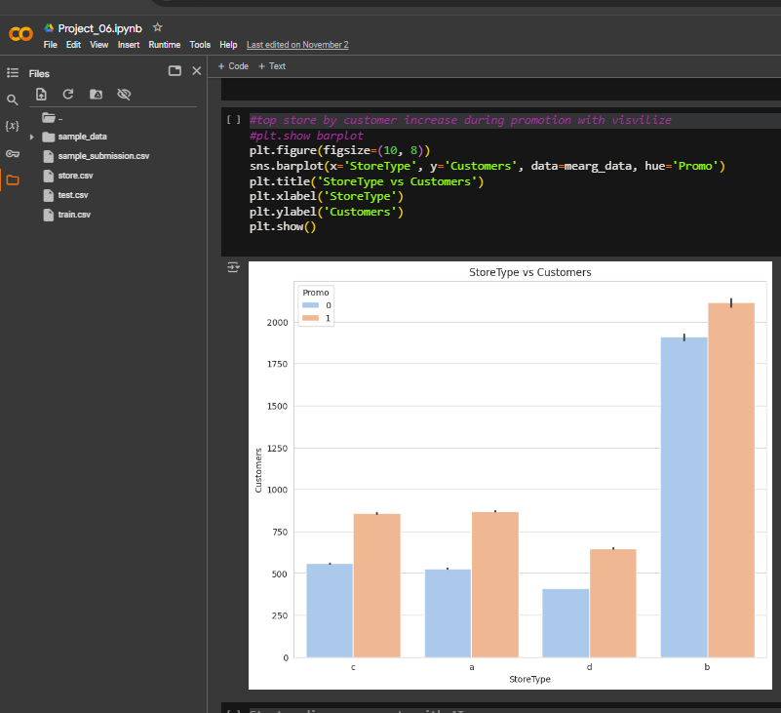

Slide 26
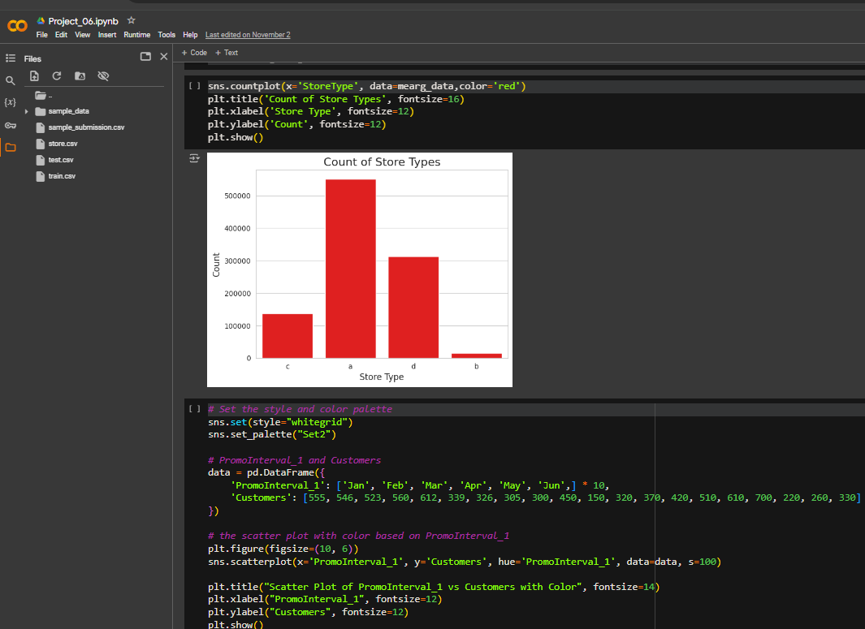

Slide 27
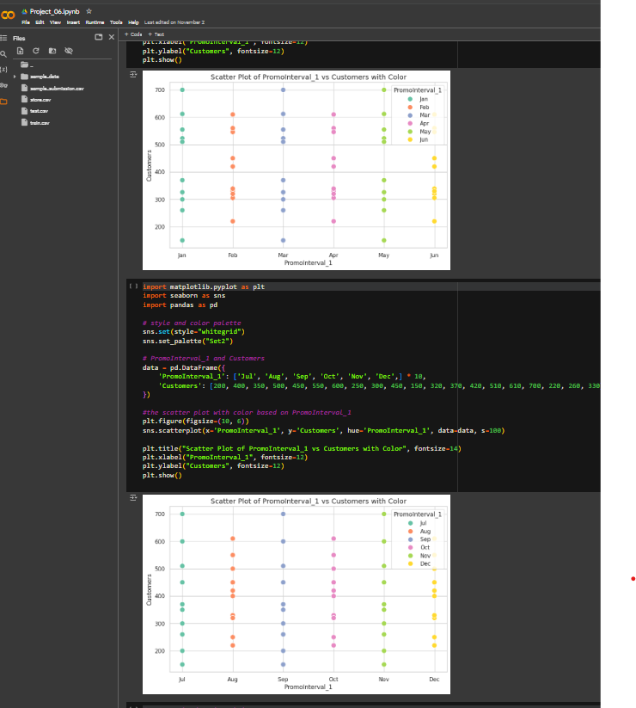
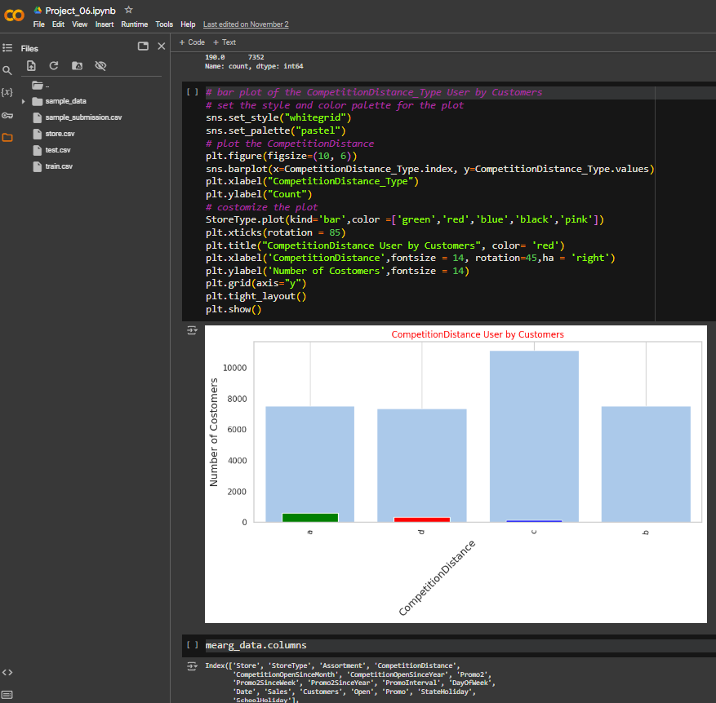

Slide 28
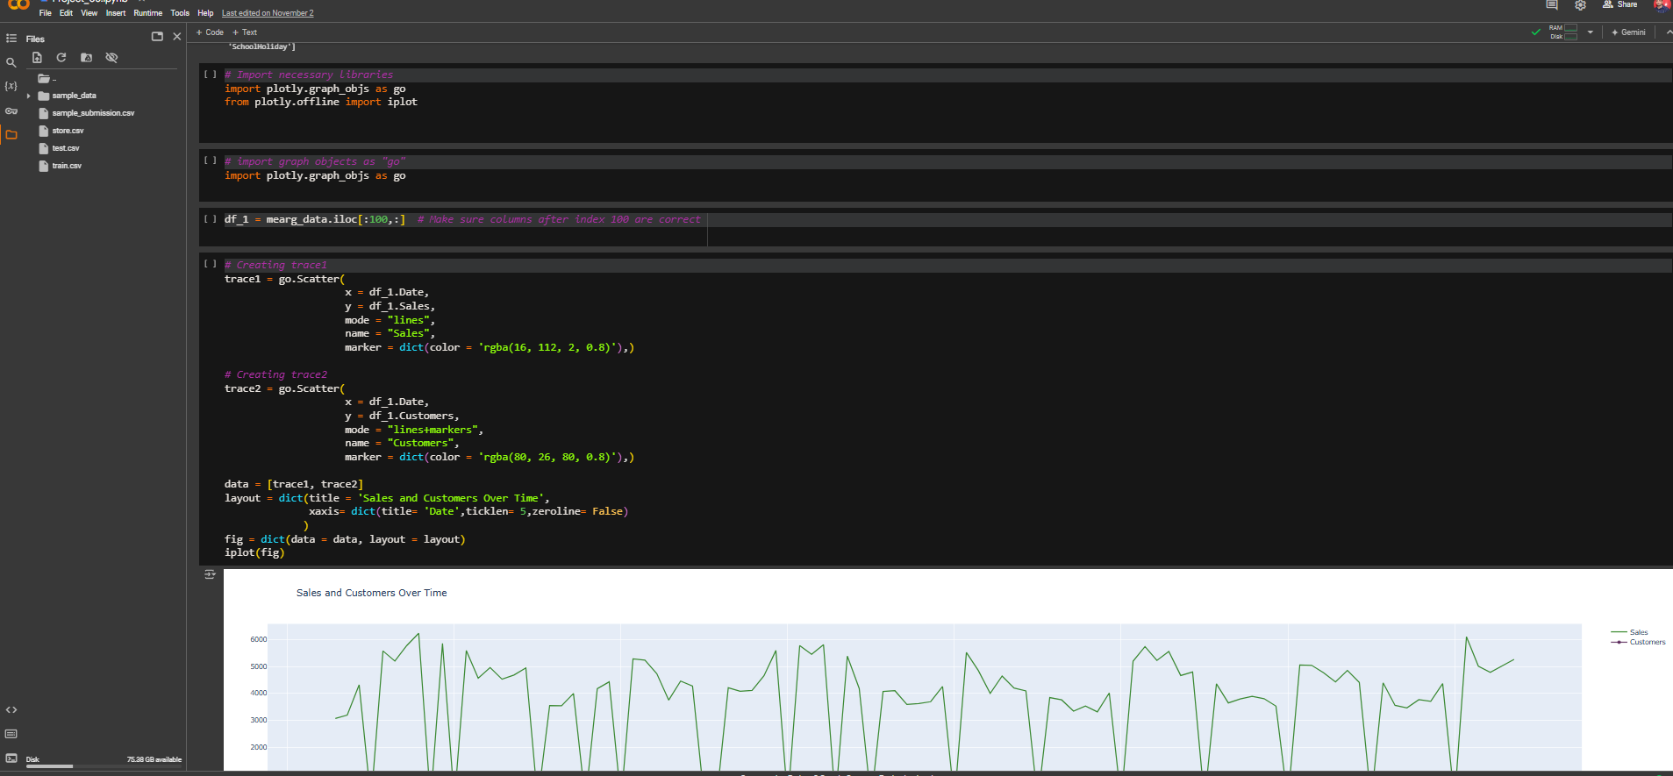

Slide 29
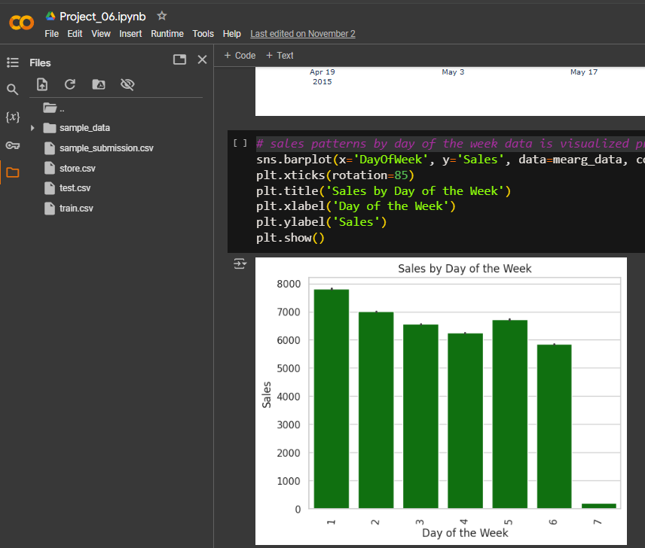
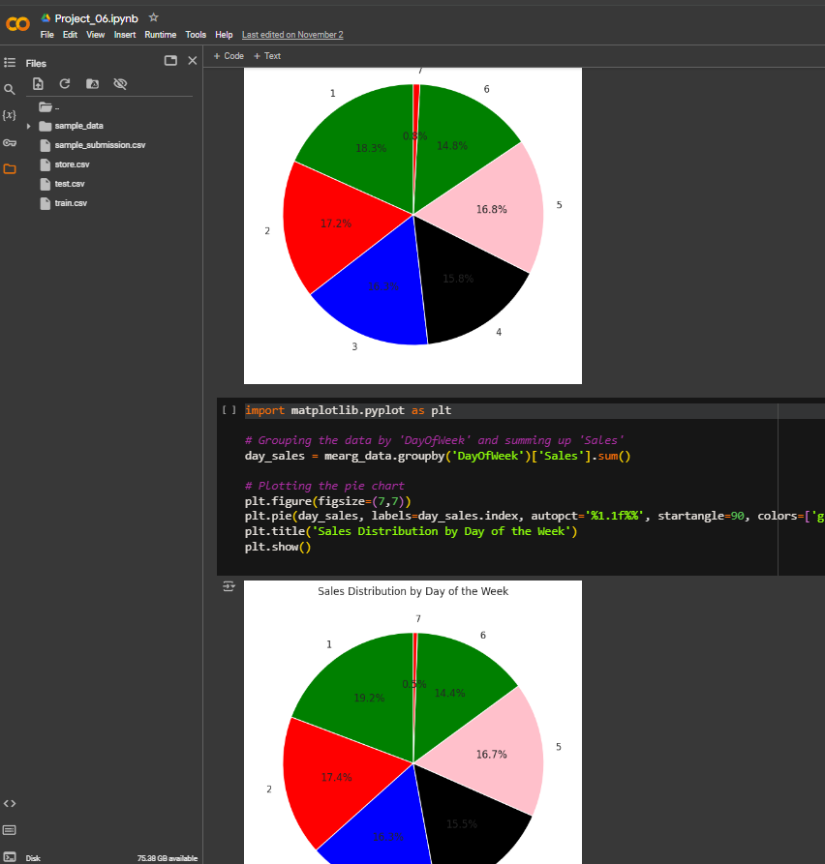

Slide 30
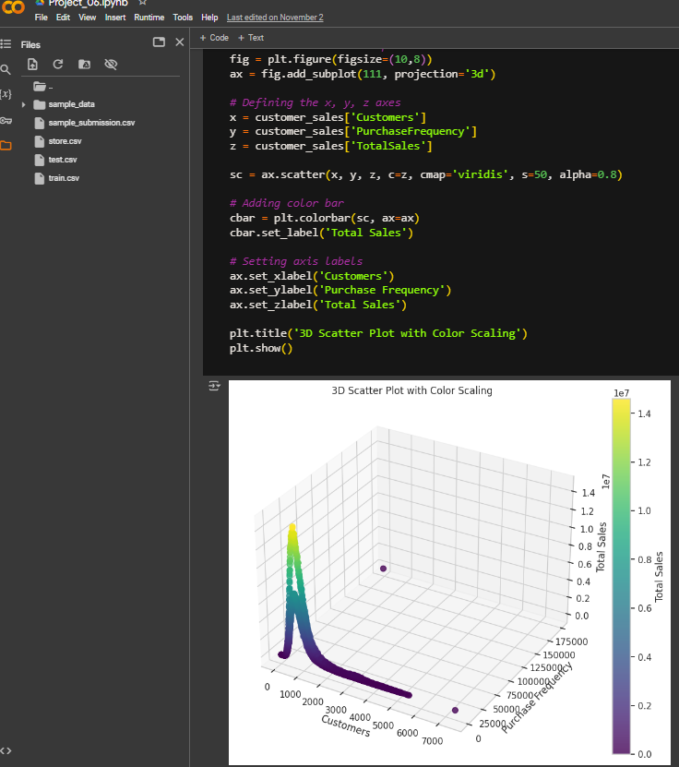
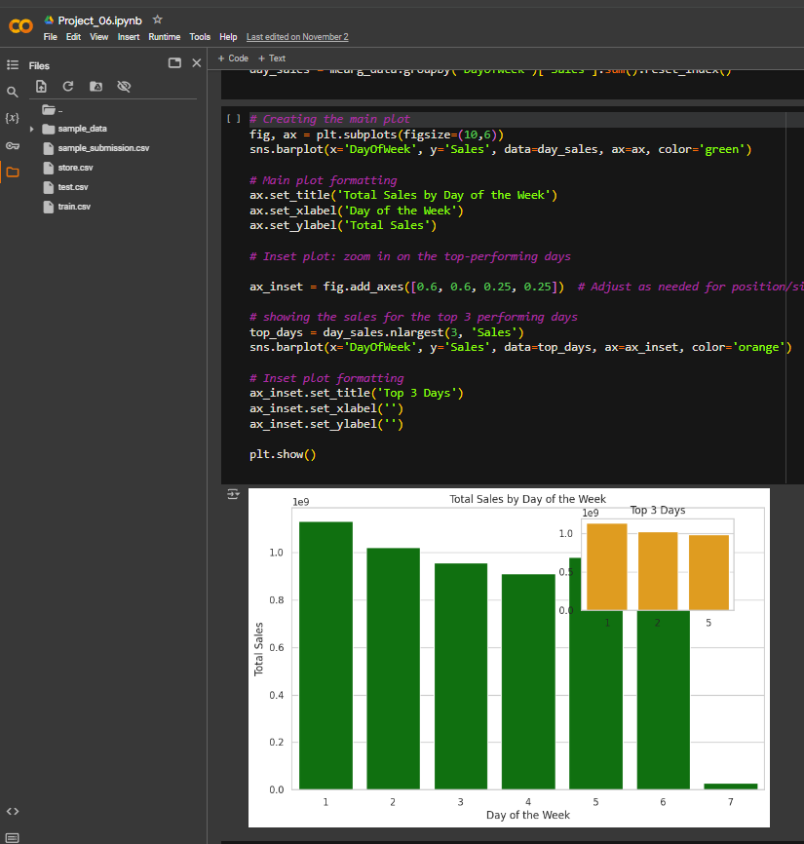

Slide 31
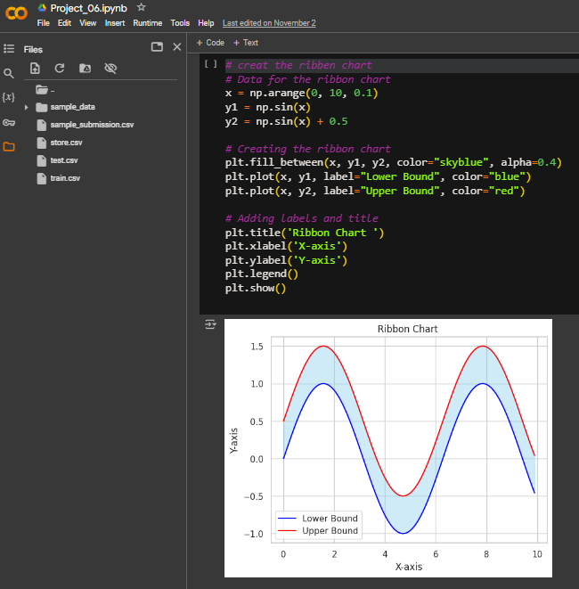
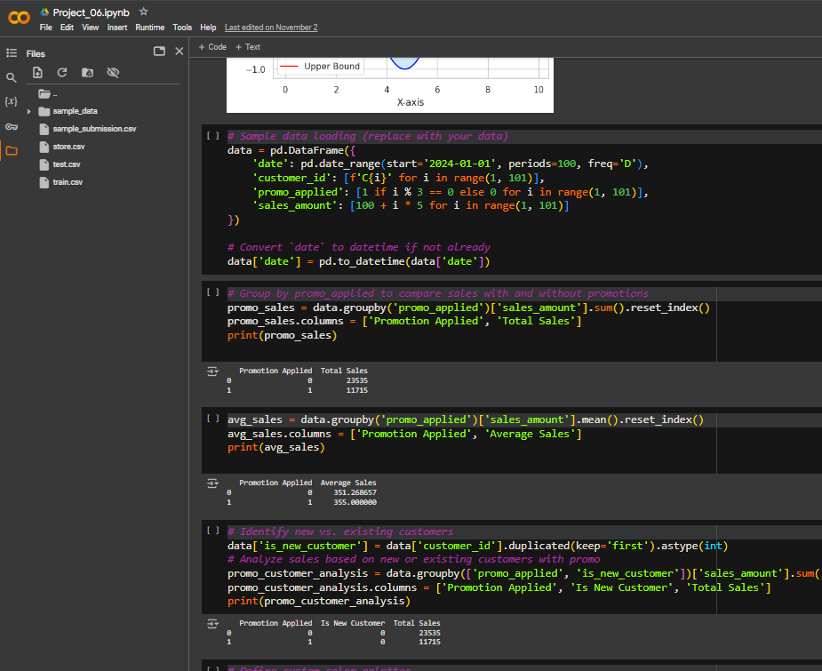

Slide 32
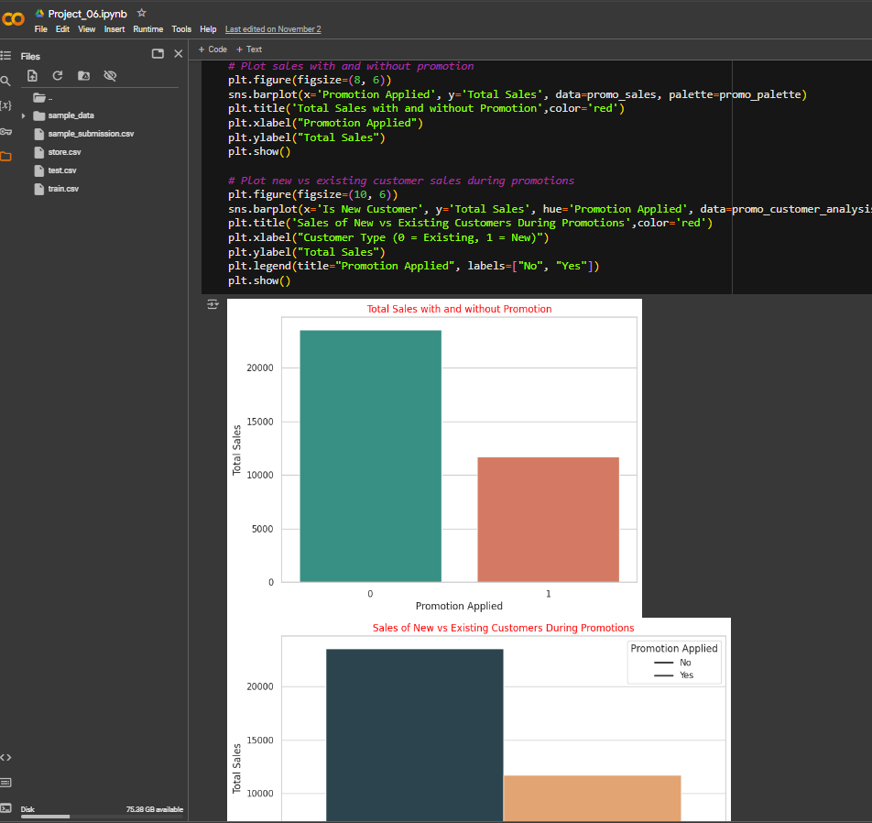
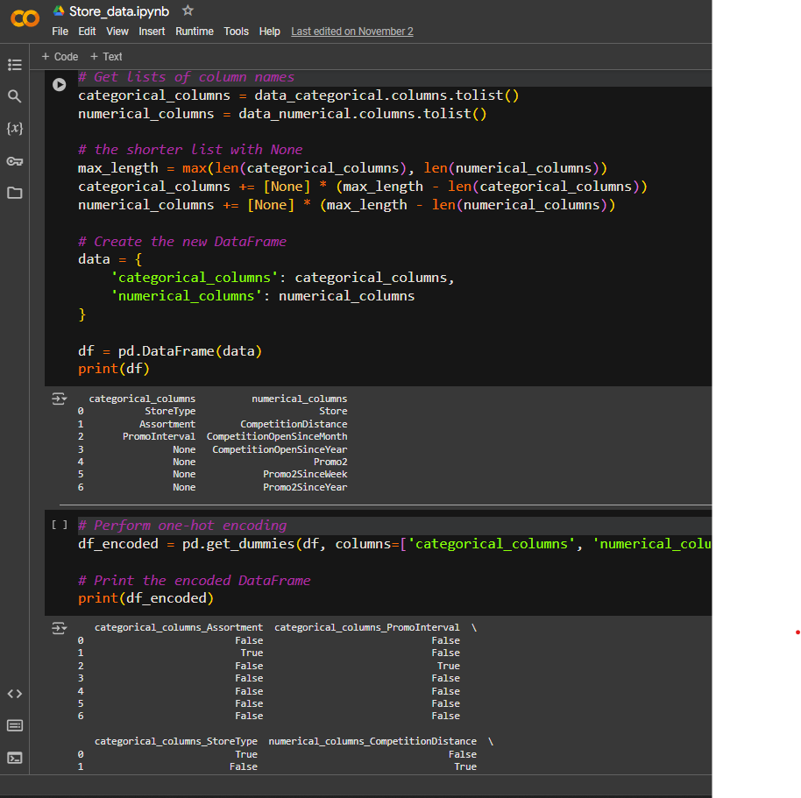

Slide 33
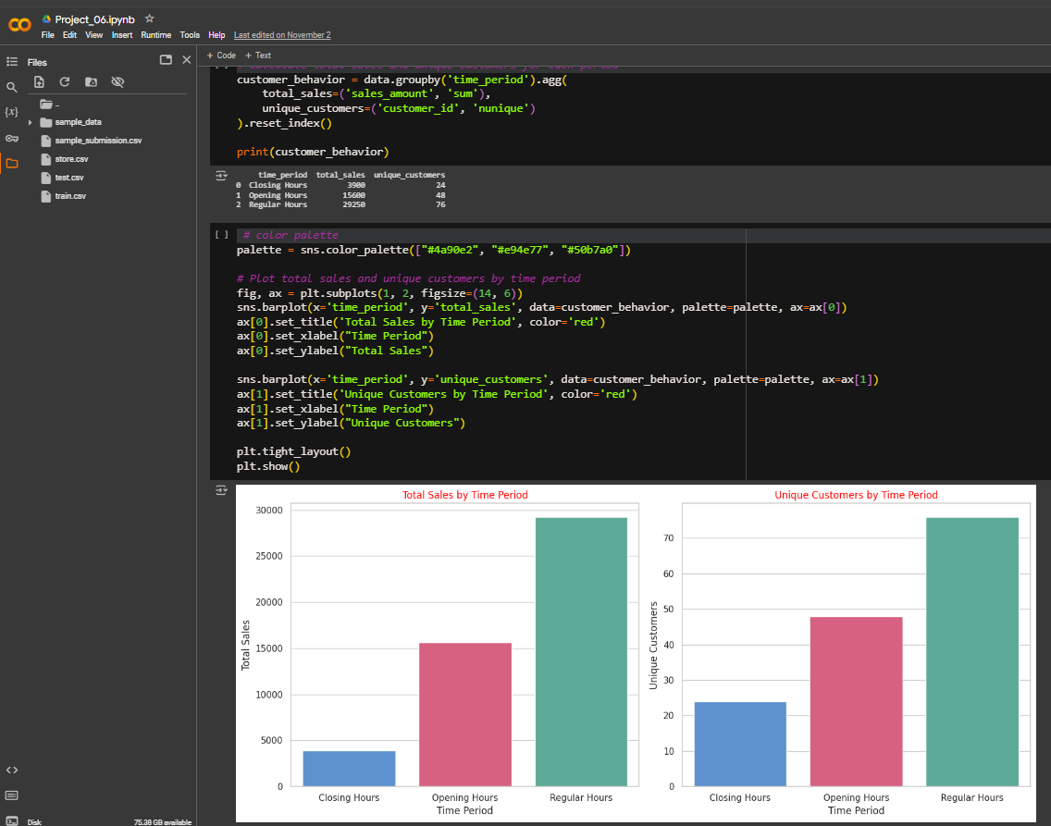

Slide 34
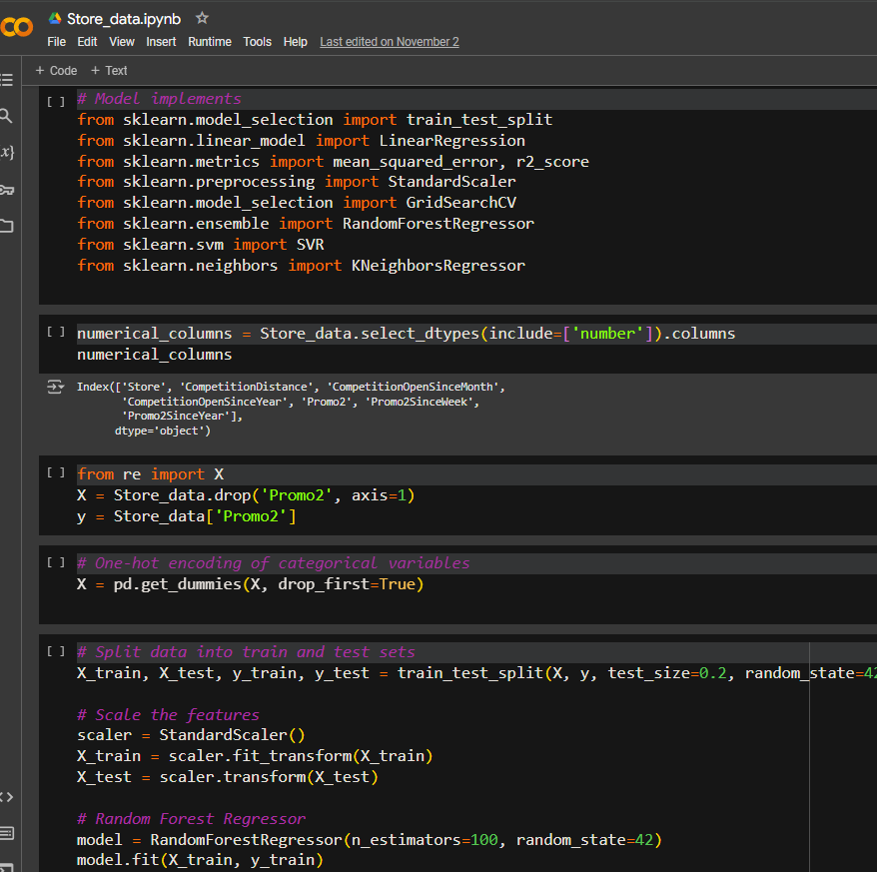
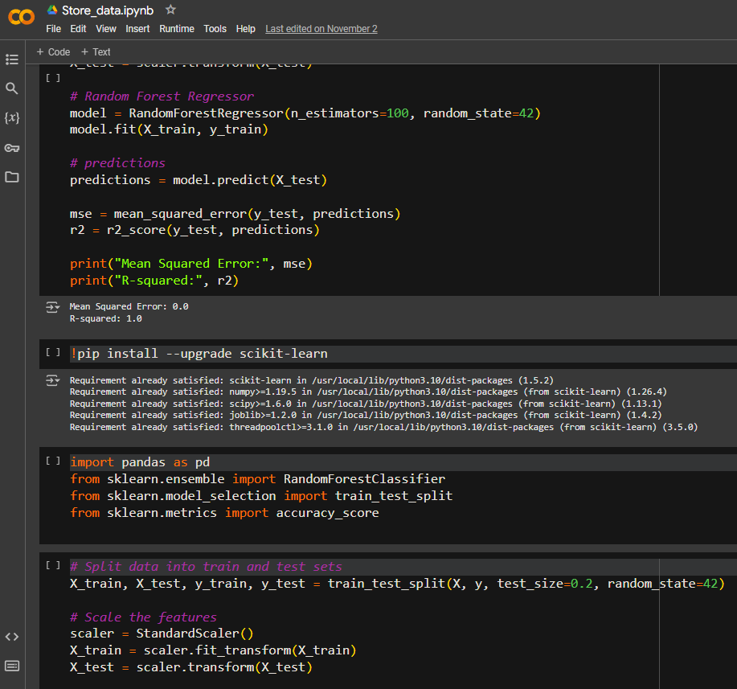

Slide 35
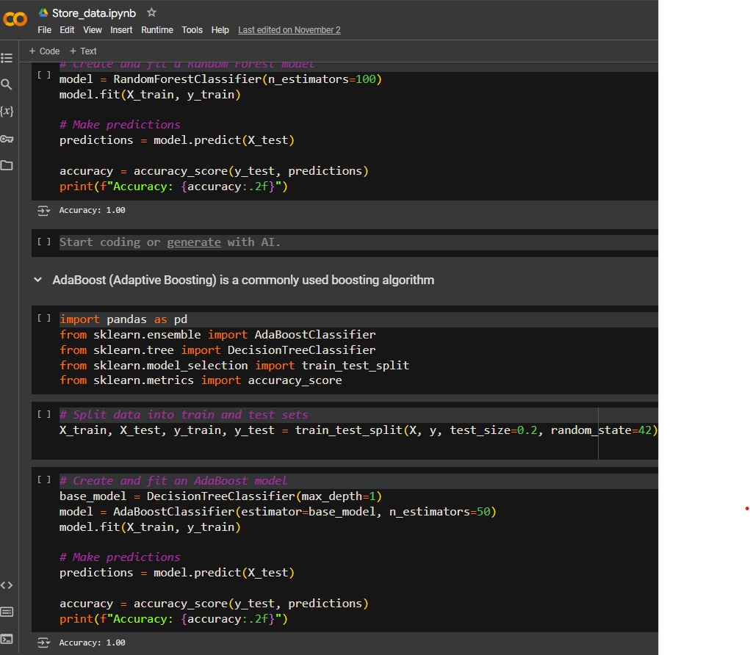
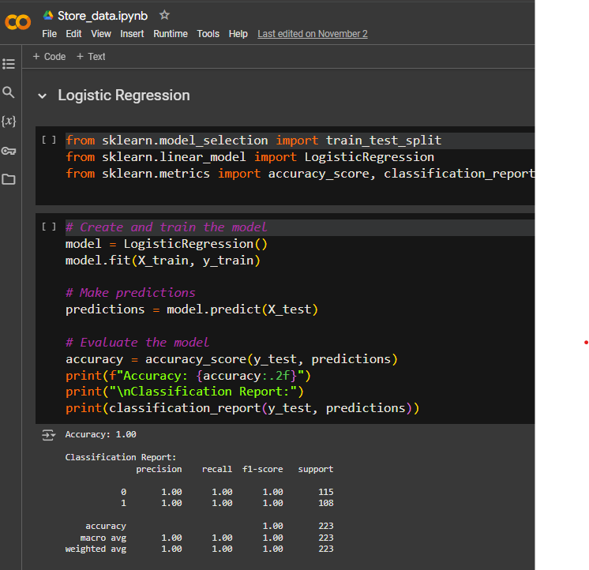

Slide 36
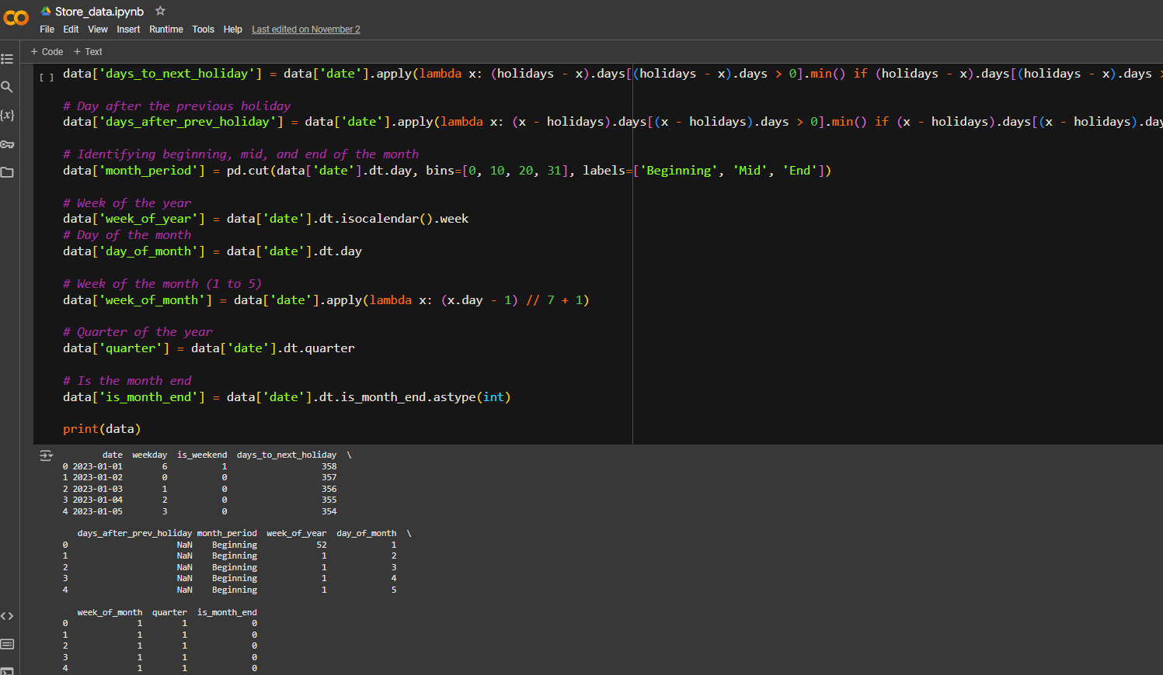

Slide 37
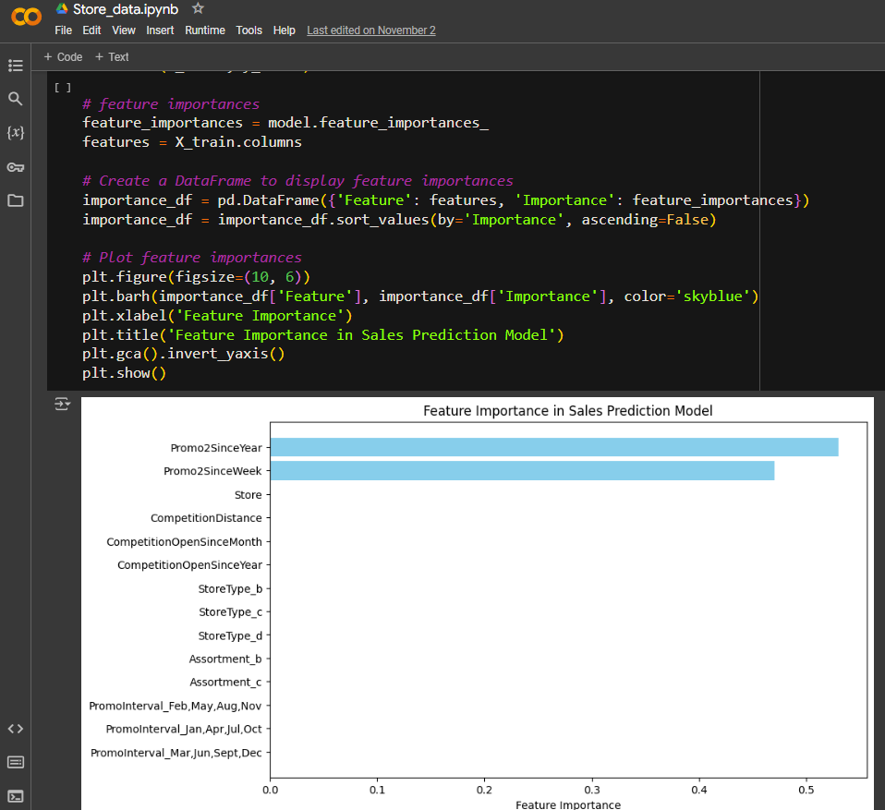

Slide 38
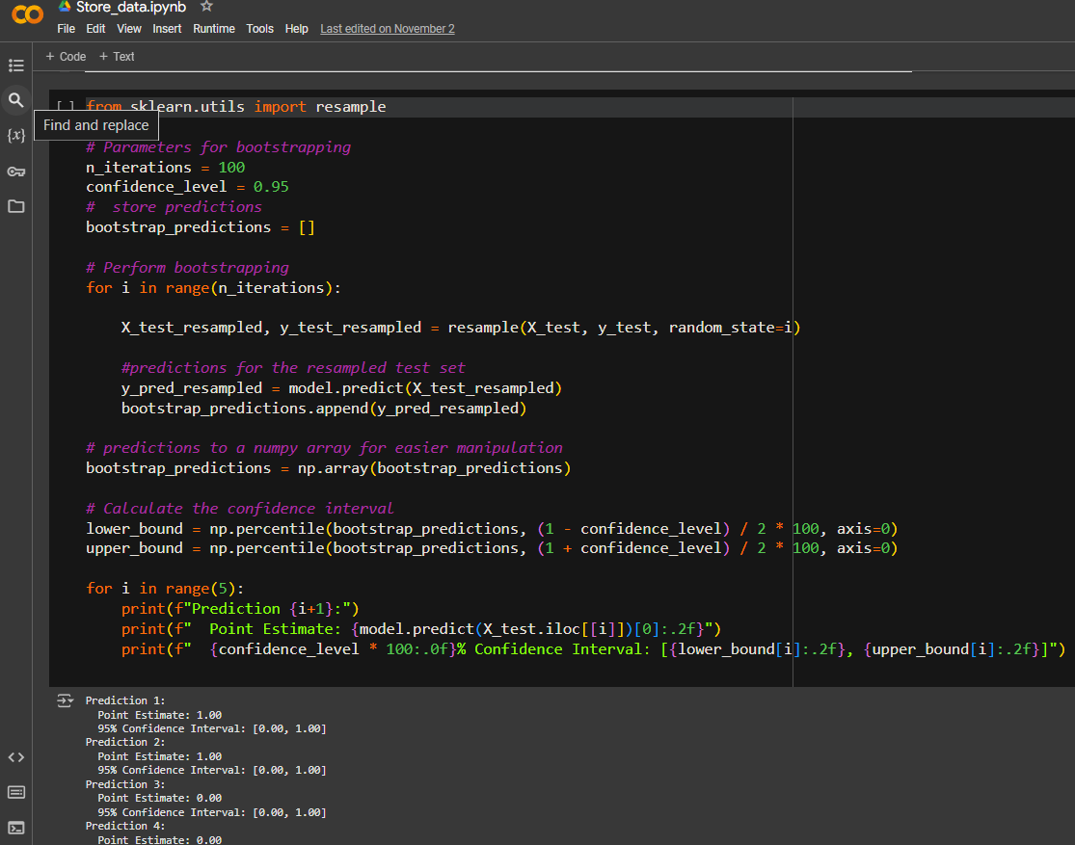

Slide 39
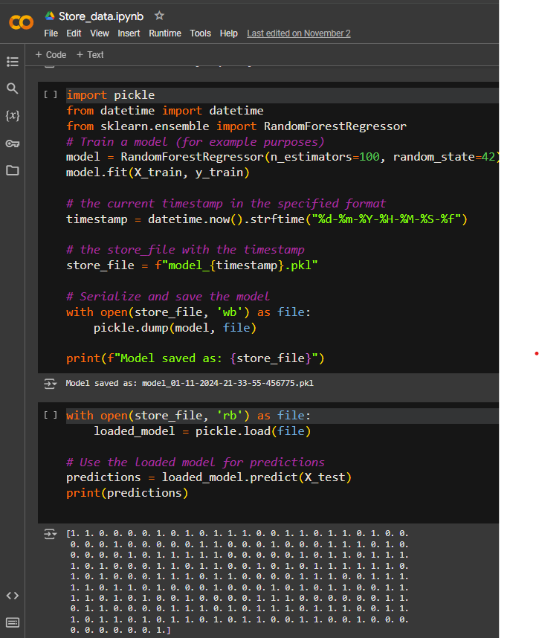

JAI HIND

